Slide 1
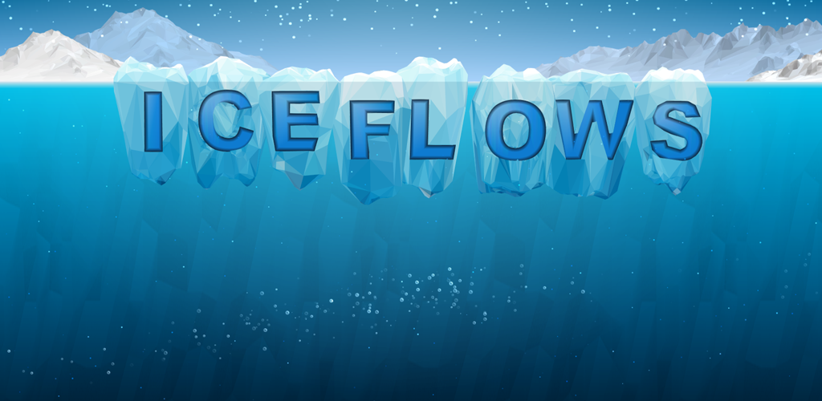
Lesson 2: Playing the Game

Slide 2
Game website http://www.iceflowsgame.com
Ice Flows Game Teacher Resource

Slide 3
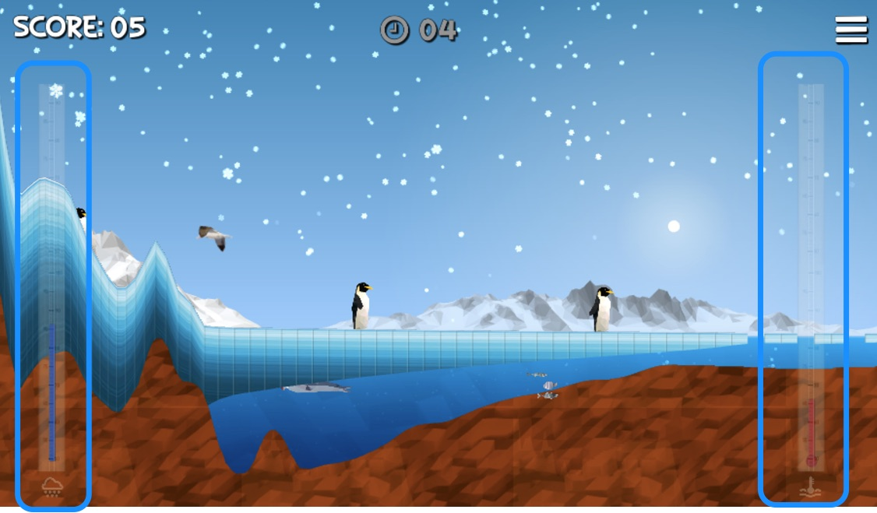
How to play the game…

Slide 4
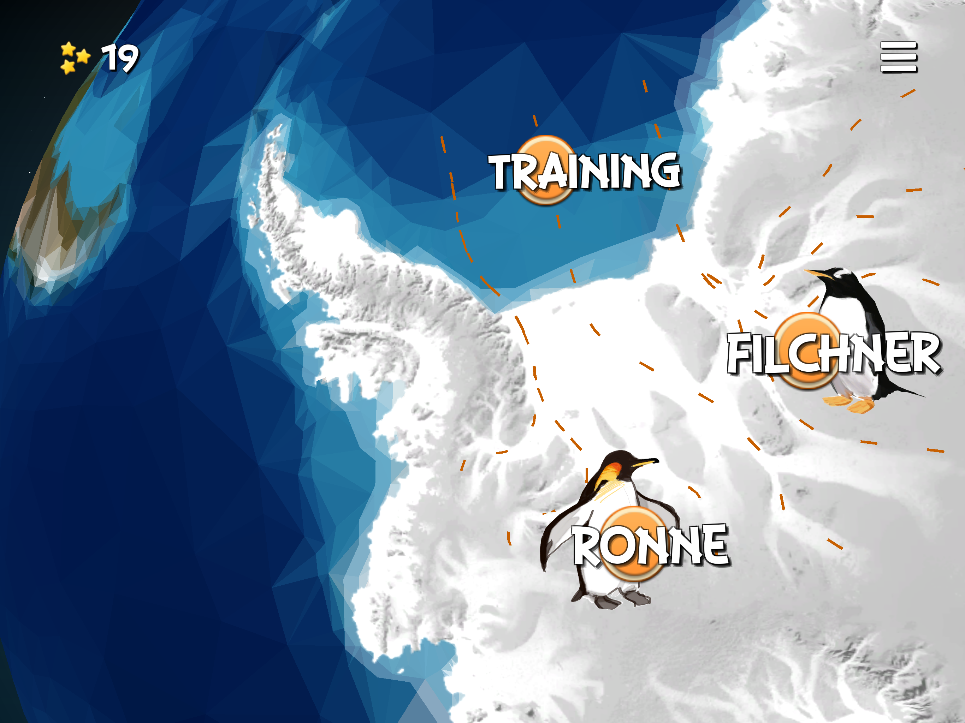

Slide 5
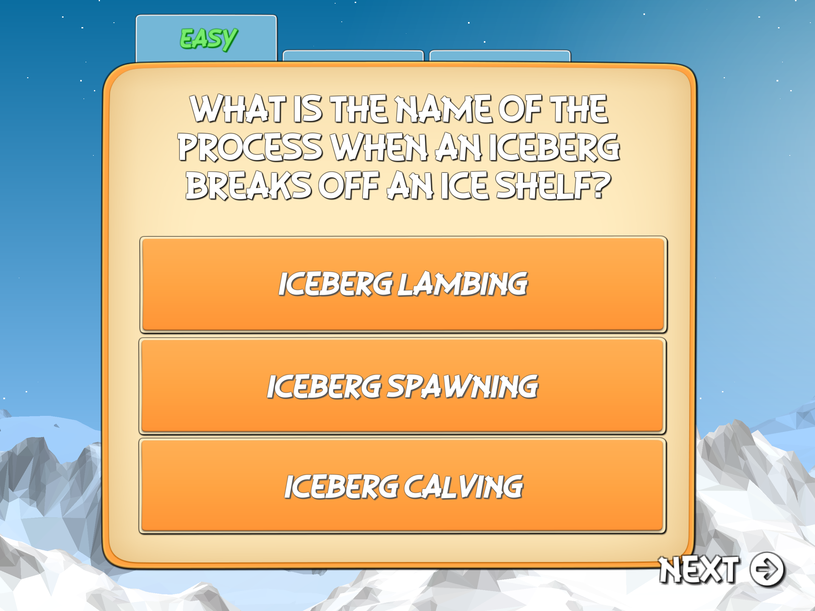
Quiz

Slide 6
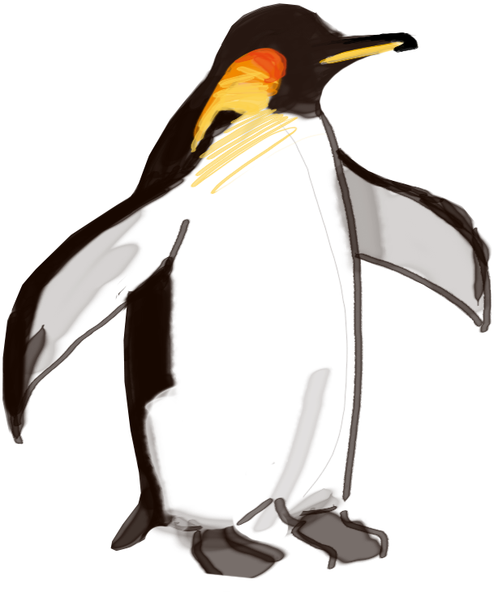
Use the Ice Sheet Model experiment sheet

Slide 7
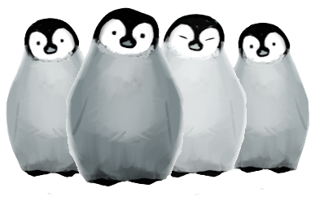
What changes would you make to the game?

Slide 8
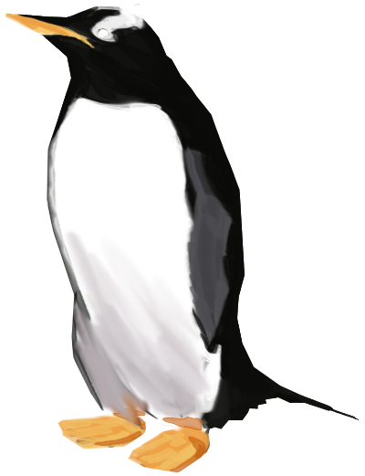
Thanks for playing!

